Slide 1


SYSTEM INFRA SOLUTIONS PRIVATE LIMITED

Slide 2

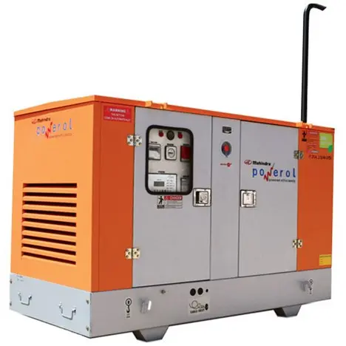
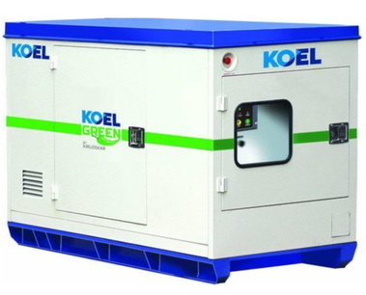
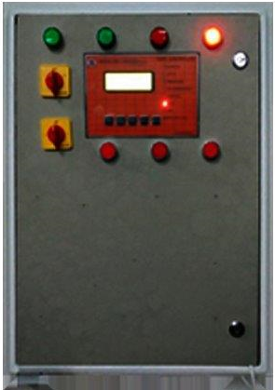
Dual DG Automation
Dual DG Panel
DG2
DG1

Slide 3
Introduction Dual DGC
Dual DG Controller is designed for Telecom BSC and MSC sites needing a full proof power backup system to manage Dual DGs alternatively or as assigned to perform, having all the time tested features of our core controller matched with higher rating switch gears according to the site needs and ratings.
It is equipped to provide site automation and control features, making it fail proof for consistent performance.

Slide 4
Features of Dual DG Controller
EB Mains and DG parameters monitoring and control.
User Settable Cyclic mode for DG’s Operation.
DG fuel & run time saver (DG start based on temperature and battery voltage).
DG set protections through monitoring LLOP, HET/HWT, Alternator Fault, RPM and Overload.
Event logs up to 5000 different events for the diagnosis of faults
Up to 50 Analog and Digital Configurable parameters. 13 P/F contact output alarms.
Driving up to 03 contactors for different combination of contactors for different DG Start-Stop logics.

Slide 5
Dual DG Single Line Diagram

Slide 6
Dual DG Auto/Manual Selection
Auto mode
Dual DG Controller operate in the auto mode and feed the power to load from mains in all possible conditions. Whenever mains fail, DG controller wait for site battery to discharge to set level or shelter temperature to rise to set level to turn on the DG and feed the power from DG to load. In the auto mode, required set of contactors get on & off automatically depending mains phases’ availability. If any abnormal events happen, DG controller turns off the contactors and generate appropriate PF output alarm & lit the LED indication.
Manual mode
Dual DG Controller can be made to operate in the manual mode to transfer the load to DG manually. There is a rocker on/off switch named as auto/manual switch in the DG Controller, which has to be turned on to push DG Controller in to manual mode. As this switch gets on DG Controller goes into self-manual mode operation and displays mode of operation in the front display. Then DG Controller waits for DG to get turned on manually by technician.

Slide 7
Dual DG Analog Monitoring Parameter
3Ø Phase Mains Input voltage | 1Ø - 3Ø Phase output load Current R-Y-B Output Load Current
1Ø - 3Ø Phase DG Input voltage BTS battery voltage DG battery voltage Room Temperature Mains Run hours DG Run hours BTS Battery Run hours
Mains frequency
DG frequency Mains Energy
DG Energy

Slide 8
Dual DG Digital Monitoring Parameter
Smoke Fire
Door open
High room temperature
BTS battery low
DG battery low
Overload.
DG Fail to START
DG Fail to STOP
DG HALF FUEL.
DG LOW FUEL.
DG LLOP
High Engine Temperature
DG Over Speed

Slide 9
Dual DG Digital Alarm PF Contact
Mains Fail
Load on DG-1
Load on DG-2
DG Fail to Start
DG Fail To Stop
DG Common Fault
HCT/HWT
LLOP
LFL
Over Speed
Fire/ Smoke
Over Load
High Room Temperature

Slide 10
Thank You

