Slide 1




Remote Monitoring Solution
for telecom sites
using Artificial Intelligence & Machine Learning
SYSTEM INFRA SOLUTIONS PRIVATE LIMITED
(An ISO 9001:2015, 14001:2015, 45001:2018 certified company)

Slide 2
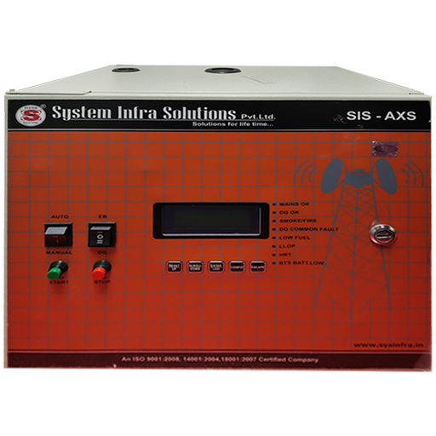
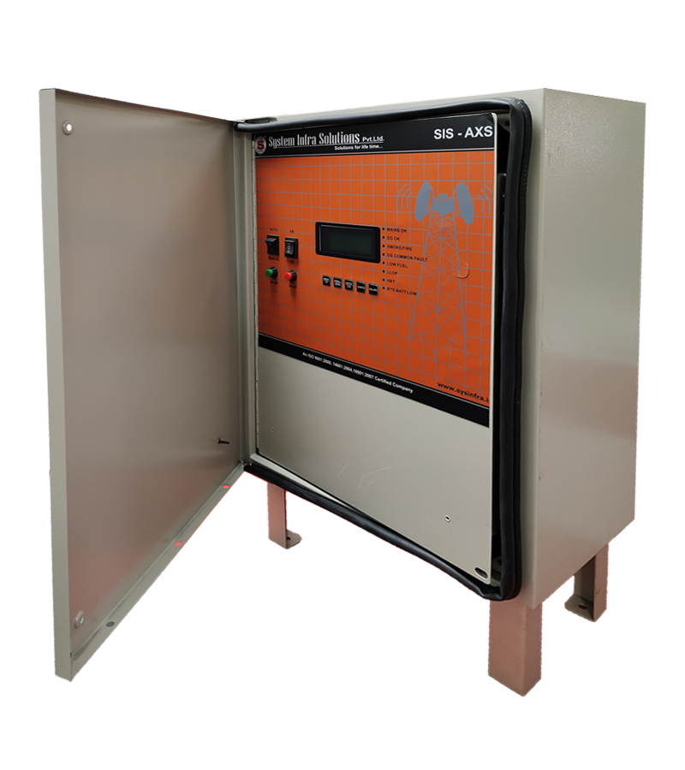
AMF Panel
Auto mains failure system (AMF) is one of the flagship products of system infra solutions.
It can work seamlessly either on 1ø/2ø/3ø supply and it enhances power utilization from DG, Mains and Battery
It has an additional feature of remote monitoring and controlling over a wireless network.
AMF follows a rational approach towards power management through
  AC Power measurement (1 ø/2 ø/3 ø)
  DG Parameter Monitoring & control
  Alarm consolidation
  GPRS Remote Management (optional)
  Fuel Management (Optional)
Power Rating supported by AMF panel is 15 KVA to 30 KVA.
Indoor
Outdoor

Slide 3
Category | Specification |  | Features
Controller | support all appended logics |  | Support all appended logics & conditions. Has 4 spare fault channels, 20 Event fault log (name of event, time & date at engine hours )
Input logics of EB & DG | EB 1 Ph | DG 3 Ph | Automation, Manual logics performance with safety alarm provision
 | EB 1 Ph | DG 1 Ph | Automation, Manual logics performance with safety alarm provision
 | EB 3 Ph | DG 1 Ph | Automation, Manual logics performance with safety alarm provision
 | EB 3 Ph | DG 3 Ph | Automation, Manual logics performance with safety alarm provision
DG Protection | DG Freq :46-65 Hz. |  | DG Freq :46-65 Hz.
 | DG-LV-1Ph-180 |  | Auto reset
 | DG-OV--1Ph-260 |  | Auto reset
 | HCT/HWT |  | Hard reset
 | LLOP |  | Hard reset
 | LFL |  | Auto reset
 | Over load |  | Hard reset
 | Over speed |  | Hard reset
 | Engine fail to start |  | Hard reset
 | Fire alarm |  | PFC will be provided From Shelter Sensor, Site power to disconnect
 | Engine fail to stop |  | Hard reset
DG start/stop | 3 attempt start | As per settable | 1 sec delay in every crank attempt
 | 1 Attempt Stop | As per settable | field settable 20 to 50 sec
DG Start / run / rest Logic (in case of EB fail & non EB) (Fuel optimizer) | Voltage DC | Below Set limit menu settable | Field settable Range - 20 -60V for 48V system
 | Voltage EB | Below Set limit - Menu settable | As per set level
 | Temp. Shelter | More than set limit - Menu-settable | 15 - 60 Deg. C (extended temp. sensor with PFC at shelter)
 | DG run In Hrs | Run-Menu settable | 1 to 8 Hrs (steps of range-1 Hrs.)
 | DG rest In Hrs | Rest-Menu settable | 5 to 600 Minutes (steps of range-5 mts.)
Boost Charging Mode | Menu settable interval in 1 to 1440 Hrs | Continuous Power Supply for 12 | Field Settable

Slide 4
Category | Specification |  | Features
Dry Contacts( PFC's) | HCT/HWT
 | LLOP
 | LFL
 | Over load
 | Over speed
 | DG Common Fault
 | DG Fail to Start
 | DG Fail to Stop
 | High Shelter Temp
 | DG On Load |  | From Contactor Status
 | Mains Fail |  | From Contactor Status
 | Fire Alarm
HMR Hard memory | DG Hours |  | Cumulative up to xxxxxxx.x digit (7.1 digit)
 | Mains Duration |  | Cumulative up to xxxxxxx.x digit (7.1 digit)
DG Battery Charging | Static charger |  | Required in both mode DG and EB
Emergency S/w | Required
Indicating & recording parameters (can be covered under controller display) | Required
 | EB - DG Voltages |  | Indicating
 | EB - DG load |  | Currents
 | EB - DG frequency |  | Currents
 | KWH |  | Cumulative temper proof
 | DG HMR |  | Cumulative temper proof
 | EB HMR |  | Cumulative temper proof
Visual Indication(LED) | Load on mains, Load on DG, DG failure, DG start failure, Engine overload, HCT & LLOP and Over Speed. Charging |  | Load on mains, Load on DG, DG failure, DG start failure, Engine overload, HCT & LLOP and Over Speed.
Indicating gauges | Fuel Level indicator
 | High cylinder/water temperature gauge
 | Oil pressure gauge
Switches/Push button | Auto/Manual, Mains contractor & DG Contractor ON, engine start.
 | AMF bypass switch (for mains & DG supply)
Earthing Bar |  |  | Earth connection bar inside the panel, with provision of 5 to 8 holes of 8mm dia.
Cable & accessories | Power cables as per KVA rating of DG
Cable entry | 50mm dia hole with gromet -Qty-2 , 38mm dia hole with gromet- Qty 2

Slide 5

Address : Plot No. 382, Third Floor, F.I.E., Patparganj Industrial Area, New Delhi -110092
+91-011-35004142, +91-011-35004143, sales@sysinfra.in ;www.sysinfra.in

